Slide 1
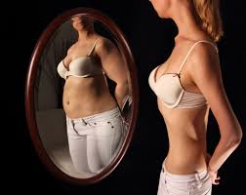
Bulimia
Noe Armijo-A3 Heath

Slide 2
What is Bulimia
“Bulimia nervosa is an eating disorder characterized by frequent episodes of binge eating, followed by frantic efforts to avoid gaining weight. It affects women and men of all ages.”

Slide 3
What is triggers Bulimia
The cause of bulimia is not clear, but it probably results from a combination of genetics, family behaviors and social values

Slide 4
Who has Bulimia
Bulimia Statistics
“Bulimia is the second most common eating disorder among teens. Between 1 and 3 percent of teens suffer from bulimia each year in the United States. Most bulimics develop the disorder during their teenage years.”
3 million people of all ages and genders suffer from bulimia In U.S.

Slide 5
How to treat Bulimia
Treatments include
Counseling
Medications
Nutrition Education

Slide 6
Sources
http://www.helpguide.org/articles/eating-disorders/bulimia-nervosa.htm
http://www.newportacademy.com/bulimia-treatment/statistics/
http://www.mayoclinic.org/diseases-conditions/bulimia/basics/definition/con-20033050
http://www.nationaleatingdisorders.org/treatment

