Slide 1
Meritocracy
Chloe Hoffman, Suliana Gonzales, Noe Armilllloooooo, and Josh Martin

Slide 2
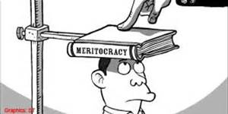
Introduction
Meritocracy is a governmental system where only people who have a certain level of education or ability are allowed to rule.

Slide 3
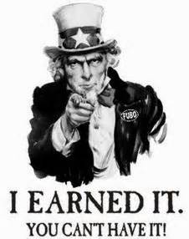
How It Works
In order for a person to campaign for office they must pass a series of tests and evaluations to gauge if a person is fit to rule or hold positions of power.

Slide 4
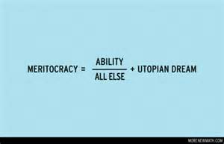
Pros
Fair and Egalitarian (in theory)
impoverished can advanced with hard work
Encourages hard work

Slide 5
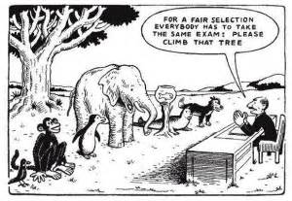
Con
Can be transformed into elitist and inequality
Creates a society where profit and intelligence are all that matters.
Elitist class

Slide 6
Singapore
Has a large middle class
Actual equality of opportunity hasn’t changed
Current system in favor of those with potential
Employers evaluate their employees
Early Childhood Development Agency

Slide 7
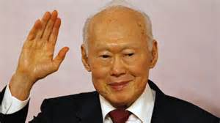
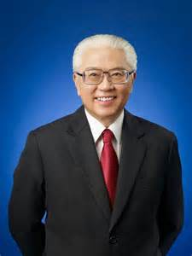
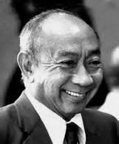
Political figures
Lee Kuan Yew – founding father
Goh Keng Swee
Tony TAN Keng Yam – current president
Lee Kuan Yew
Goh Keng Swee
Tony TAN Keng Yam

Slide 8
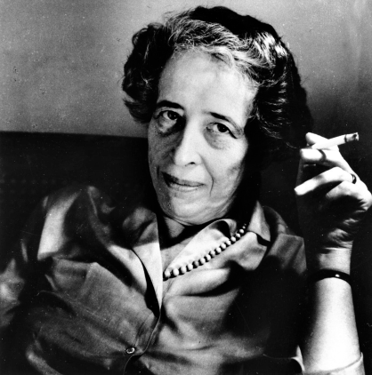
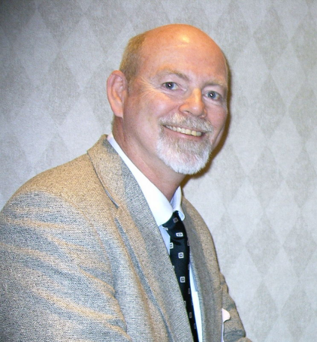
Meritocracy Theorists
Michael Young-The Rise of the Meritocracy (1958)
Hannah Arendt-crisis in education (1958)
Michael Young
Stephen J. McNamee-The Meritocracy Myth (2004)
Hannah Arendt
Stephen J. McNamee

Slide 9
Bibliography
Prakash, Pravin. "Understanding Meritocracy." TODAYonline. Web. 28 Jan. 2016.
https://www.cia.gov/library/publications/resources/the-world-factbook/geos/sn.html

